Slide 1

SRM Business Case Deck
Template deck for stakeholder alignment, showing ROI & gaining approval
Replace bracketed/orange text and numbers with your own data & information.

Slide 2
1. Executive Summary
Decisions required
Why now?
Approve SRM program/initiative and budget (subscription + implementation).
Confirm executive sponsor and steering group.
Agree timeline for Phase 1 go-live and ROI tracking.
Supplier risk and compliance requirements are increasing.
Current supplier data is fragmented across tools and spreadsheets
We need faster, more reliable supplier onboarding and governance.
We require a structured framework to measure supplier performance.
Our supply chain has a large reputational risk exposure w/o proper management
We can capture measurable ROI within months, not years
Expected outcomes (Year 1)
Single source of truth for suppliers, contracts, and risk.
Reduced manual effort in onboarding, assessments, and follow-ups.
Improved governance and visibility across procurement, risk, and ESG.
Quantified savings using agreed ROI model and KPI tracking.
Estimated annual savings: [€X - €Y]
Payback: [X] months
Phase 1 go-live: [Month, Year]
[Replace with your numbers]

Slide 3


2. Our Current State
How we are working today
The Business impact it has
Supplier data scattered across ERP, shared drives, email, and spreadsheets.
Manual onboarding and assessments create delays and rework.
Limited visibility into supplier performance, risks, and contract obligations.
Inconsistent processes across functions, regions, or business units.
Manual follow-up on supplier quality issues and/or corrective actions.
Higher operating cost (manual admin, duplicated work).
Risk exposure (missed expiries, incomplete due diligence).
Slower decisions (no consolidated view for leadership).
Hard to scale governance and ESG reporting requirements

Slide 4



3. The Cost of inaction
The Cost of poor SRM falls into three buckets
Operational
Tactical
Higher operating cost (manual admin, duplicated work).
Risk exposure (missed expiries, incomplete due diligence).
Slower decisions (no consolidated view for leadership).
Hard to scale governance and ESG reporting requirements
Strategic
Time spent chasing supplier data, documents, and approvals across systems
Duplicate supplier records and inconsistent data across ERP/Spreadsheets/SharePoint
Spreadsheet maintenance and manual reporting instead of real-time visibility.
Manual onboarding and re-approvals slow down vendor enablement (can take months)
Maverick spend and poor contract compliance result in spend leakage
Supplier onboarding delays risk coverage and slows risk escalation
Slow escalation on emerging supplier risks due to fragmented data and manual checks
Reduced resilience to disruptions, impacting revenue and customer commitments
Slower innovation and growth with key suppliers due to limited collaboration and visibility
Harder to meet ESG and regulatory expectations without consistent supplier data
60% more savings are lost due to maverick spend and poor contract compliance
(Hackett 2025)
Companies lose 6-10% of annual revenue
due to supply chain disruptions
(The Economist 2024)
Supplier onboarding can take 6 months, delaying risk coverage (ISM 2025)
46% of supply chain leaders cite siloed data
as a barrier (McKinsey 2024)

Slide 5
3. Cost of inaction - Example calculations
Edit this example COI calculation with your own numbers
Operational
Tactical
Higher operating cost (manual admin, duplicated work).
Risk exposure (missed expiries, incomplete due diligence).
Slower decisions (no consolidated view for leadership).
Hard to scale governance and ESG reporting requirements
Strategic
Manual Inefficiency
& Time Wasted:
+30% FTE with manual SRM
€70 000 (FTE salary) x 20 (employees)
= €1 400 000 (total cost)
x 30% (inefficiency)
= €420 000 (Annual COI)
Savings leakage from maverick spend + poor compliance
€50 000 000 (annual addressable spend)
x 2 (leakage %)
= €1 000 000 (Annual COI)
Companies with structured SRM processes see a 20–30% drop in supply chain disruptions and quality issues.
Example: If a disruption costs €100,000 per incident, reducing just two events/year saves €200,000–€300,000.

Slide 6
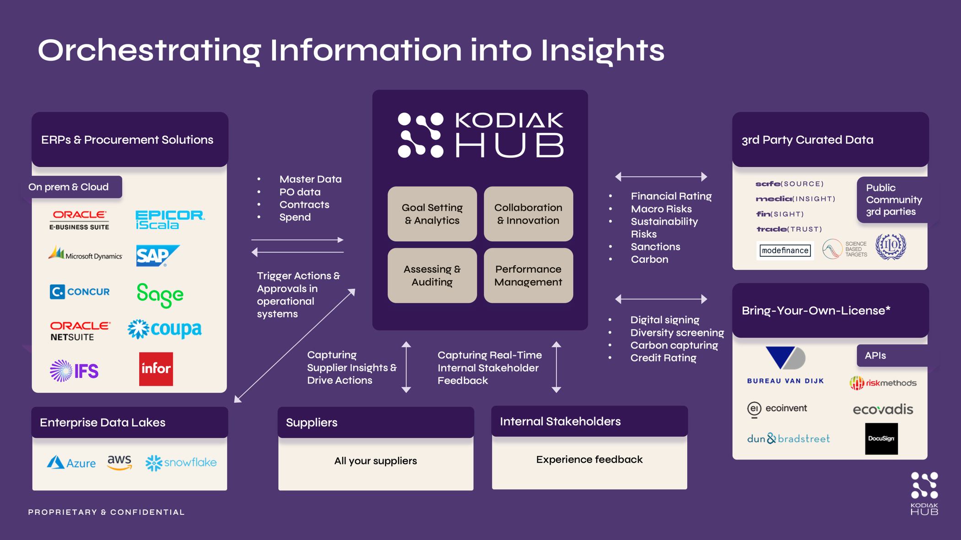
4. Our Target State
A dedicated SRM Suite that consolidates supplier data, workflows, and insights while integrating with our existing systems.
SRM Suite

Slide 7
5. ROI & Value Calculations
Use the ROI model below as a template. Replace all bracketed values with your inputs.
Or use this ROI-calculator: https://www.kodiakhub.com/srm-roi-calculator
Higher operating cost (manual admin, duplicated work).
Risk exposure (missed expiries, incomplete due diligence).
Slower decisions (no consolidated view for leadership).
Hard to scale governance and ESG reporting requirements
Total Spend Savings
Time Savings
Audit Efficiency
Inputs needed: Total annual procurement spend
Assumption: Tail spend is ∼20% of total procurement spend
*Estimated savings range: 3-5% of tail spend
Formula: Total annual spend x 0,20 x (0,03-0,05) = annual savings on tail spend
Inputs needed: Number of supplier onboardings per month
Assumptions: Companies spend on average 10-20 manual hours per onboarding. Avg. yearly salary is €70 000.
*Estimated % of automated tasks: ∼80% of manual work
Formula: Onboardings per month × 12 × (10-20) × 80% × (€70 000 ÷ 1 920 h) = annual savings onboarding
Inputs needed: Number of supplier audits per year & avg. cost per audit
*Estimated Savings: ∼20% on audit costs
Formula: Number of audits per year x avg. cost per audit x 20% = annual savings on audits
Total estimated annual savings: [€X - €Y]
Total Cost Year 1 for SRM software: [€X]
Payback: [X] months
*Estimations from customers of Kodiak Hub

Slide 8
6. Integration & IT view
How an SRM Suite fits the stack without a heavy digital transformation
Integration principles
The SRM Suite acts as the hub and supplier intelligence layer. It does not replace the ERP/P2P/S2P - it connects to them to consolidate supplier info, enrich it with risk/ESG, and feed insights back.
Keep supplier data synchronized so insights are usable across platforms.
Modular rollout - start small and expand scope over time.
Bring Your Own License for third-party risk and ESG data providers where relevant.
ERP/P2P
Risk/ESG Data
SRM Suite
Workflows + insights
Typical data flows
In: supplier master, spend and contract metadata, category and org data.
In: risk and ESG data feeds as needed (BYOL or preferred providers).
Out: enriched supplier profiles, statuses, and insights pushed back where helpful.
Integration methods
API/integration platforms | Message bus/Service bus | SFTP | Direct DB (SQL)
Users: Procurement, Quality,
Risk, ESG, Finance

Slide 9

7. Implementation plan
Week 0-2
Week 2-6
Week 6-10
Week 10-14
Kickoff + Scope
Data + Config
Launch + Baseline
Go-Live + Scale
Workstreams:
Data: supplier master, categories, contracts
Configuration: modules, fields, workflows, templates
Integrations: design and build prioritized data flows
Pilot: top suppliers and key stakeholders
Deliverables:
Supplier master unified in one place
Onboarding and assessments live for Phase 1 scope
Dashboards for risk and data completeness
ROI tracking baseline and first monthly report

Slide 10
8. Governance & Data quality
SRM is the hub that connects Procurement, Risk, ESG & Finance by centralizing supplier data into a single source of truth, while keeping it current through workflows and automation.
Controls that scale:
Standardized supplier profiles and fields
Orchestrated onboarding and self-assessments
Automated alerts for missing or outdated data
Audit-friendly history of changes and actions
What Leadership Gets:
Clear supplier ownership and accountability
Faster reporting with fewer manual reconciliations
Better audit readiness and control evidence
Reduced risk of decisions made on outdated data
Procurement
ESG
SRM - Single Source of Truth
Risk
Finance

Slide 11
9. Security & Compliance
ISO/IEC 27001 certification and key security capabilities such as encryption, 2FA, and SSO.
Security Overview:
ISO/IEC 27001 certified information security management system
Data encryption in transit and at rest
Single Sign-On (SSO) support
Two-Factor Authentication (2FA) option
What to include in the security pack:
Hosting and data residency options
Access control and SSO configuration
Encryption, backup, and disaster recovery
Audit logging and monitoring

Slide 12
10. Next Steps
What do we need to make this happen?
Validation of COI’s and ROI’s with finance
Budget approval
Integration & Security review with IT
Set steering group members: Procurement, IT, Risk, ESG & Finance
Time commitment

