Slide 1
Category Strategy Template
KODIAK HUB’S

Slide 2
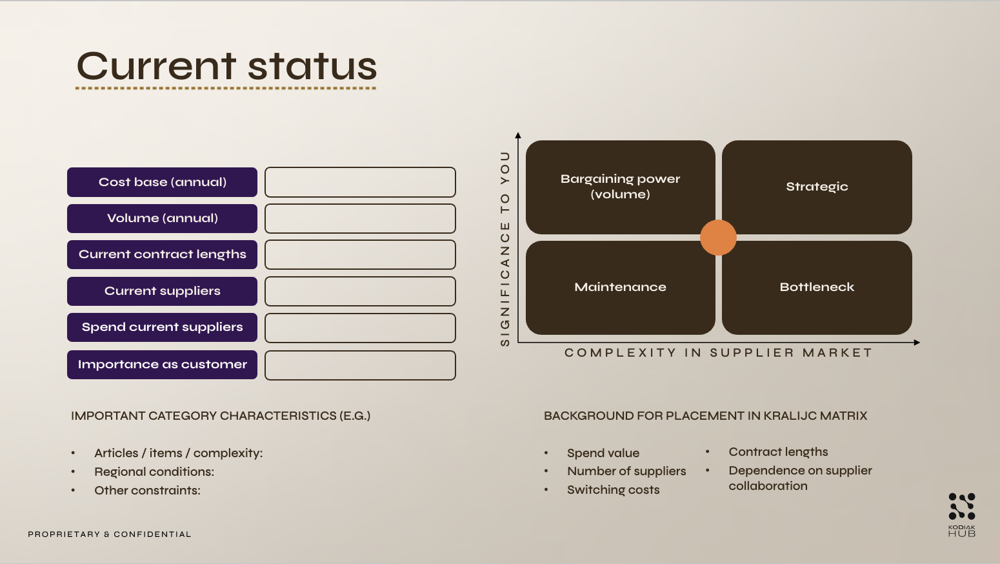
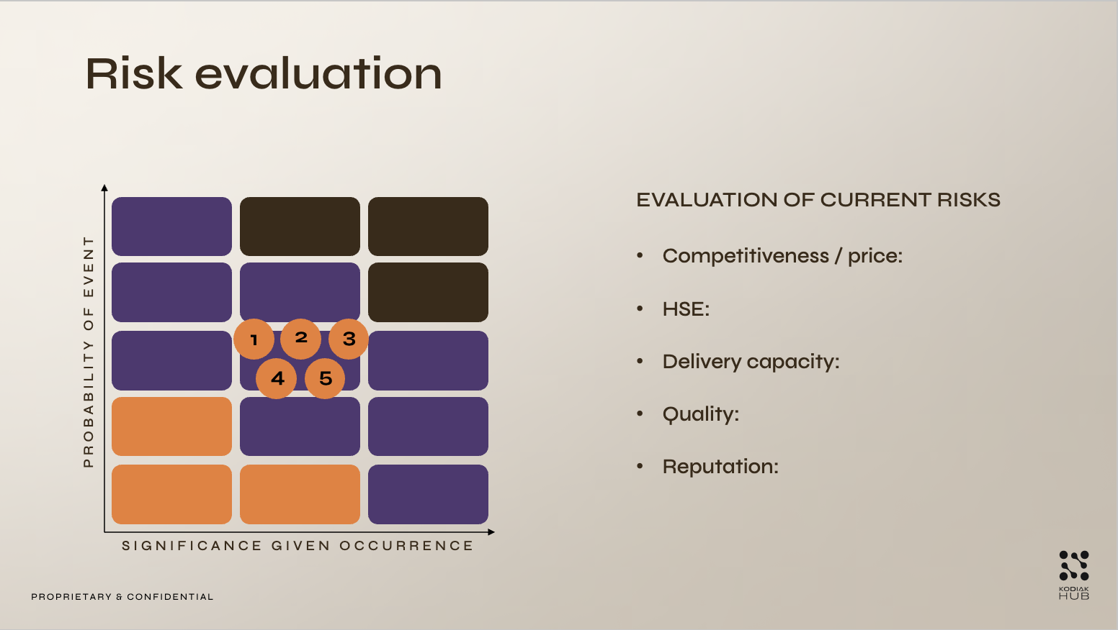
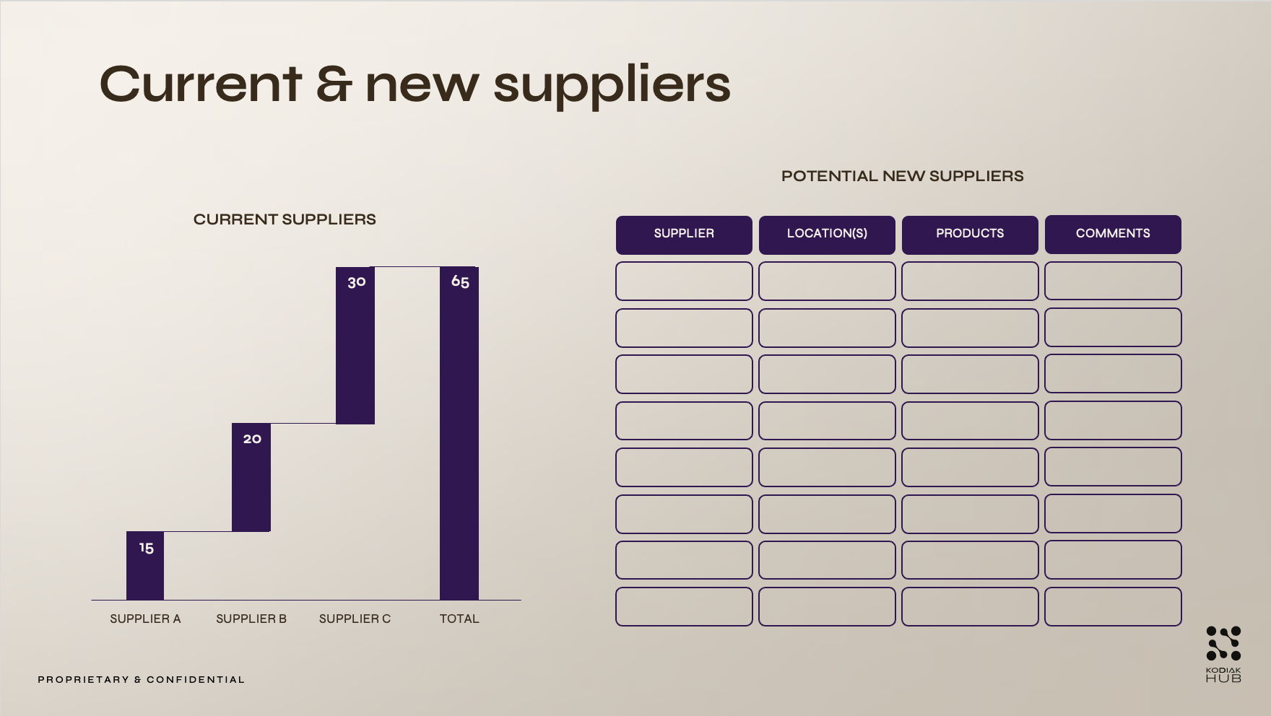
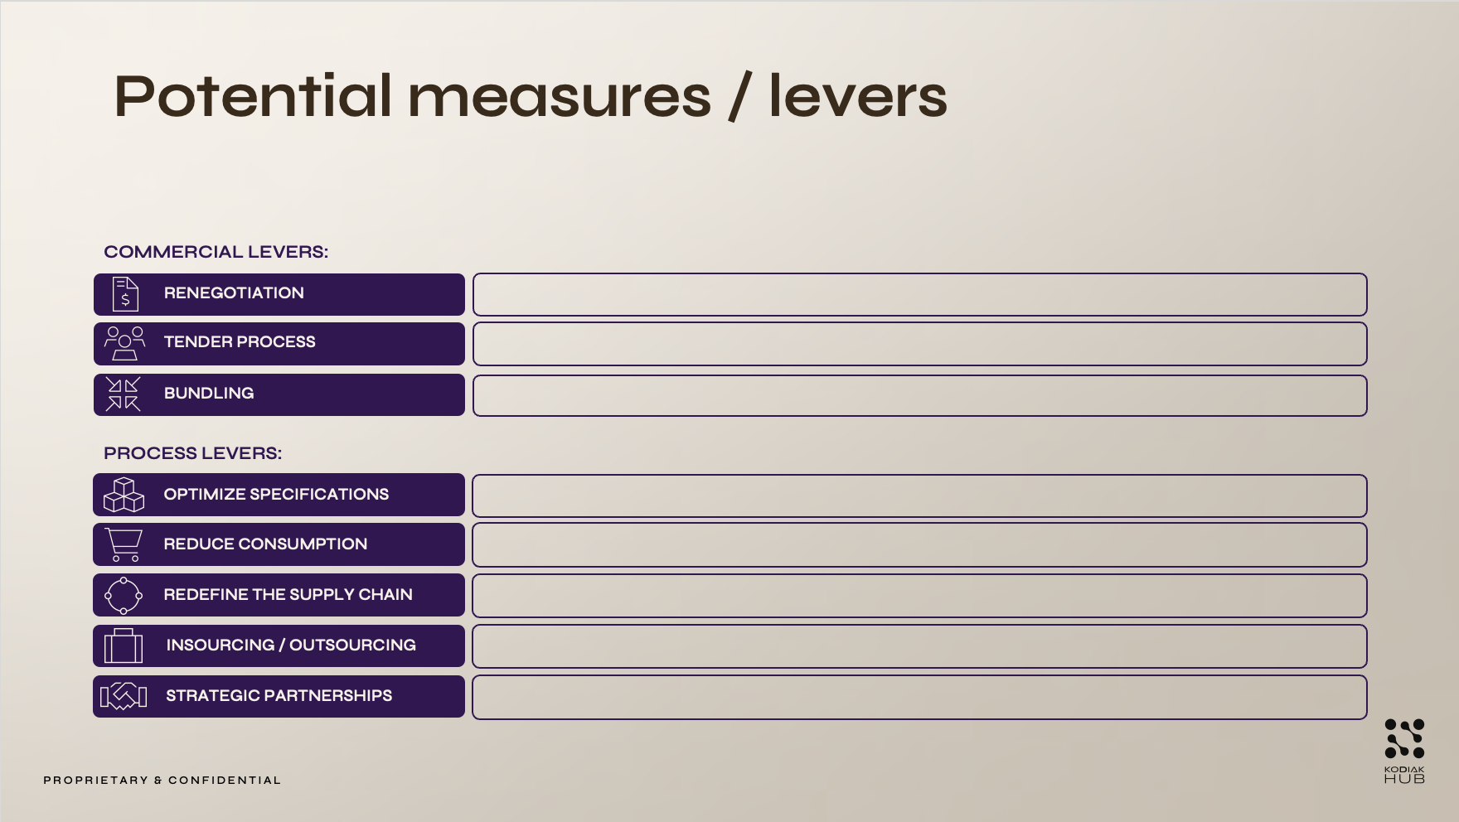
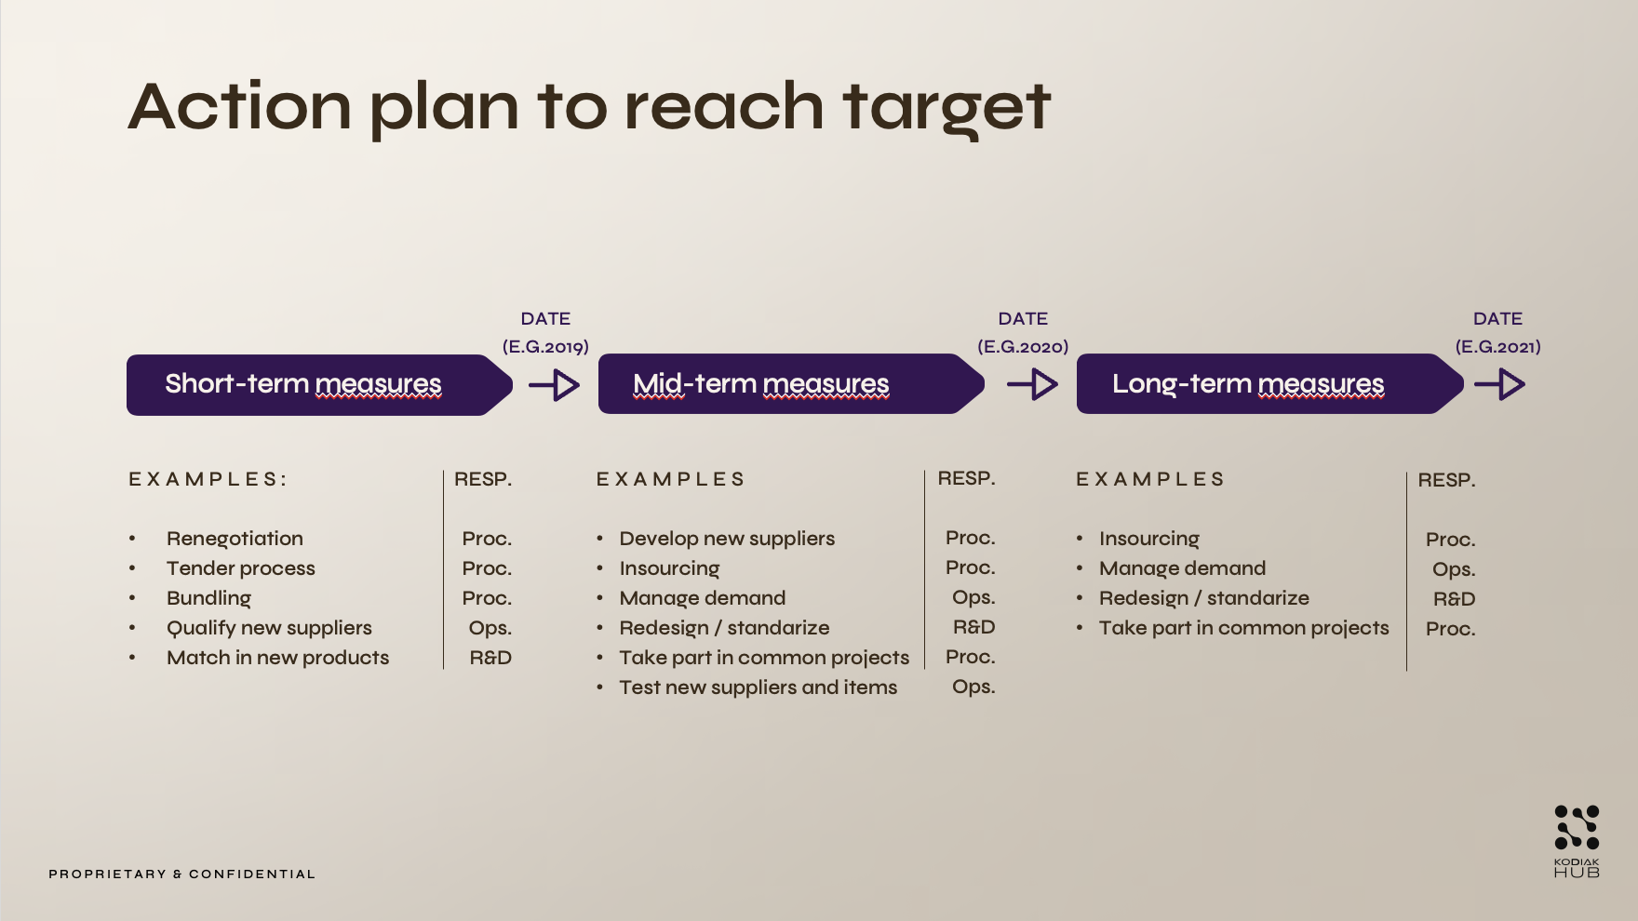
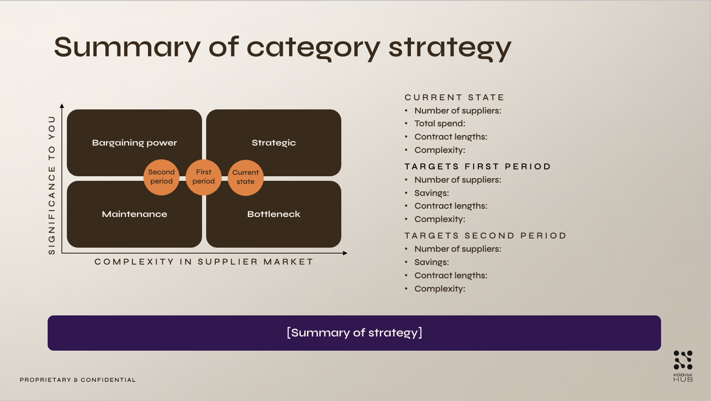
Category Strategy Template
Use this helpful template to create a clear, action-oriented strategy that aligns with your organization's goals.
1. Current status
2. Risk evaluation
3. Current & new suppliers
4. Potential measures
5. Action plan to reach target
6. Summary of strategy

Slide 3

Current status
Bargaining power (volume)
Strategic
Cost base (annual)
Volume (annual)
Current contract lengths
SIGNIFICANCE TO YOU
Bottleneck
Maintenance
Current suppliers
Spend current suppliers
Importance as customer
COMPLEXITY IN SUPPLIER MARKET
IMPORTANT CATEGORY CHARACTERISTICS (E.G.)
Articles / items / complexity:
Regional conditions:
Other constraints:
BACKGROUND FOR PLACEMENT IN KRALIJC MATRIX
Spend value
Number of suppliers
Switching costs
Contract lengths
Dependence on supplier collaboration

Slide 4
Risk evaluation
EVALUATION OF CURRENT RISKS
Competitiveness / price:
HSE:
Delivery capacity:
Quality:
Reputation:
1
2
3
PROBABILITY OF EVENT
4
5
SIGNIFICANCE GIVEN OCCURRENCE

Slide 5
Current & new suppliers
POTENTIAL NEW SUPPLIERS
CURRENT SUPPLIERS
SUPPLIER
LOCATION(S)
PRODUCTS
COMMENTS
30
65
20
15
SUPPLIER A
SUPPLIER B
SUPPLIER C
TOTAL

Slide 6








Potential measures / levers
COMMERCIAL LEVERS:
RENEGOTIATION
TENDER PROCESS
BUNDLING
PROCESS LEVERS:
OPTIMIZE SPECIFICATIONS
REDUCE CONSUMPTION
REDEFINE THE SUPPLY CHAIN
INSOURCING / OUTSOURCING
STRATEGIC PARTNERSHIPS

Slide 7


Action plan to reach target
DATE
(E.G.2019)
DATE
(E.G.2020)
DATE
(E.G.2021)
Short-term measures
Mid-term measures
Long-term measures
RESP.
Proc.
Proc.
Ops.
R&D
Proc.
Ops.
RESP.
Proc.
Proc.
Proc.
Ops.
R&D
EXAMPLES
Develop new suppliers
Insourcing
Manage demand
Redesign / standarize
Take part in common projects
Test new suppliers and items
EXAMPLES
Insourcing
Manage demand
Redesign / standarize
Take part in common projects
EXAMPLES:
Renegotiation
Tender process
Bundling
Qualify new suppliers
Match in new products
RESP.
Proc.
Ops.
R&D
Proc.

Slide 8
Summary of category strategy
CURRENT STATE
Number of suppliers:
Total spend:
Contract lengths:
Complexity:
Bargaining power
Strategic
Second
period
First
period
Current
state
TARGETS FIRST PERIOD
Number of suppliers:
Savings:
Contract lengths:
Complexity:
SIGNIFICANCE TO YOU
Bottleneck
Maintenance
TARGETS SECOND PERIOD
Number of suppliers:
Savings:
Contract lengths:
Complexity:
COMPLEXITY IN SUPPLIER MARKET
[Summary of strategy]

Slide 9
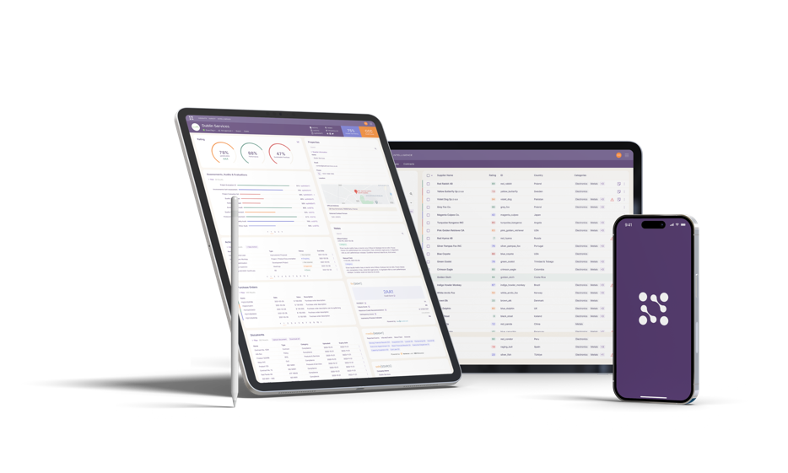
Supplier Relationships
Reimagined
Turn your supplier relationships into
a competitive advantage with
Kodiak Hub’s innovative end-to-end
Supplier Relationship Management platform.
Onboarding & Qualification
Risk & ESG Compliance
Performance & Collaboration
Innovation & Impact
Book a demo

Slide 10

INSIGHTS | INTELLIGENCE | INNOVATION | IMPACT

